Slide 1
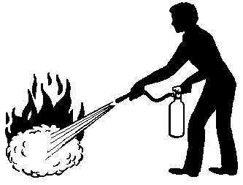
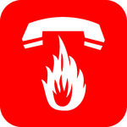
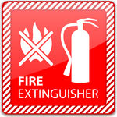
FIRE SAFETY AND EXTINGUISHER TRAINING

Slide 2
This is a basic introduction to the types of fire extinguishers used on the campus of the University of Georgia. If you would like more extensive training including hands-on use of an extinguisher and putting out a live fire, please contact:
The Office of Fire & Life Safety
Environmental Safety Division
240A Riverbend Road
Athens, Georgia 30602
(706) 542-5801
Or
E-mail Tim Lister at: timothy.lister@uga.edu
E-mail Russell D. Dukes at: rddukes@uga.edu

Slide 3
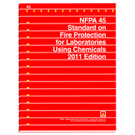
Basic Fire Safety Information:
NFPA 45
Notes:
2019 Edition is currently adopted

Slide 4
Chemistry of Fire
A rapid chemical reaction.
the self-sustaining process of rapid oxidation of a fuel, which produces
heat and light.

Slide 5
Chemistry of Fire
Extinguishment Theory
Removal of Heat
Removal of Fuel
Reducing Oxygen
WILL Inhibit Chemical
Chain Reaction

Slide 6
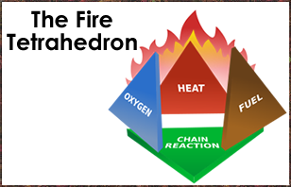
Chemistry of Fire

Slide 7
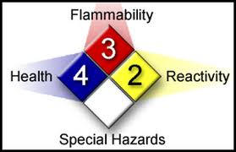
Basic Fire Safety Information:
Know Your Labeling Systems:
NFPA Diamond

Slide 8
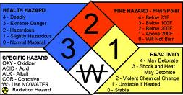
NFPA Diamond

Slide 9
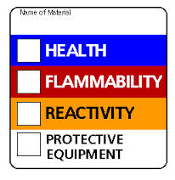
Hazardous Material Identification System

Slide 10
Other Areas of Concern:
Gas Shut Off Valves
Fire Blankets
Flammable Storage Cabinets
Post Emergency Numbers
Safety Showers
First Aid Kits

Slide 11
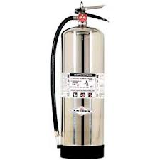
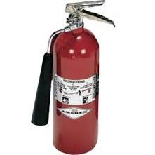
Below are the four basic types of fire extinguishers used on campus. Type D extinguishers are also used in some laboratory settings, however, the types listed below are the ones the general University community will encounter:
Type A Extinguisher (water):
Type BC Extinguisher (CO2):

Slide 12
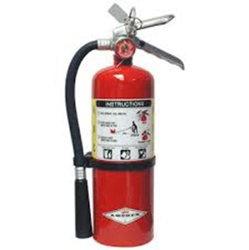
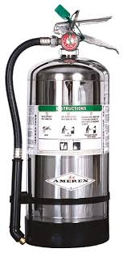
Type ABC Extinguisher (dry chemical powder):
Type K Extinguisher
(potassium acetate - wet chemical agent):

Slide 14
Types of Extinguishers
Type A Label
Type A label is in a triangle on the extinguisher. This extinguisher is used for ordinary combustibles such as cloth, wood, rubber and many plastics. These types of fires usually leave ashes after they burn. Type A extinguishers for Ashes.
International Symbol
.

Slide 15
Types of Extinguishers
Type B Label
Type B label is in a square on the extinguisher. This extinguisher is used for flammable liquid fires such as oil, gasoline, paints, lacquers, grease, and solvents. These substances often come in barrels. Type B extinguishers for Barrels.
International Symbol

Slide 16
Types of Extinguishers
Type C Label
Type C label is in a circle on the extinguisher. This extinguisher is used for electrical fires such as in wiring, fuse boxes, energized electrical equipment and other electrical sources. Electricity travels in currents. Type C extinguishers for Currents.
International Symbol

Slide 17
Types of Extinguishers
Type D Label
Type D label is in a star on the extinguisher. This extinguisher is used for metal fires such as magnesium, titanium and sodium. These types of fire are very dangerous and seldom handled by the general public. Type D for Don't get involved.
D

Slide 18
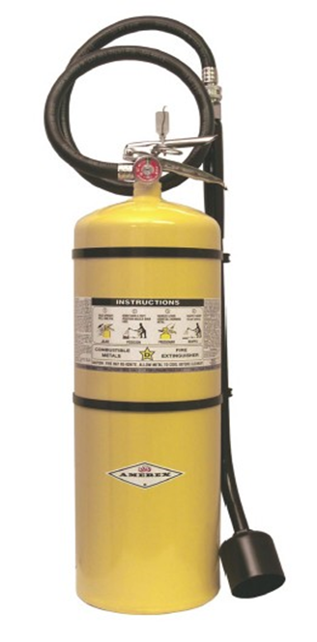
Type D Fire Extinguisher Extinguishing Agent:
For Use on Metal Fires Including: Copper Powder
Aluminum Graphite
Lithium Sodium chloride
Magnesium
Potassium
Sodium
Titanium
Uranium
Zirconium
You Must Match the Proper Agent to the Flammable Metal!
Dry Chemical is Different Than Dry Powder
Dry Chemical = ABC Type Dry Powder = Type D

Slide 19
Sodium chloride (Super-D, Met-L-X, M28, Pyrene Pyromet*) contains sodium chloride salt, which melts to form an oxygen-excluding crust over the metal. A thermoplastic additive such as nylon is added to allow the salt to more readily form a cohesive crust over the burning metal. Useful on most alkali metals including sodium and potassium, and other metals including magnesium, titanium, aluminum, and zirconium.
Copper-based (Copper Powder Navy 125S) developed by the U.S. Navy in the 1970s for hard-to-control lithium and lithium-alloy fires. The powder smothers and acts as a heat sink to dissipate heat, but also forms a copper-lithium alloy on the surface which is non-combustible and cuts off the oxygen supply. Will cling to a vertical surface. Lithium only.
Graphite-based (G-Plus, G-1, Lith-X, Chubb Pyromet) contains dry graphite that smothers burning metals. The first type developed, designed for magnesium, works on other metals as well. Unlike sodium chloride powder extinguishers, the graphite powder fire extinguishers can be used on very hot burning metal fires such as lithium, but unlike copper powder extinguishers will not stick to and extinguish flowing or vertical lithium fires. Like copper extinguishers, the graphite powder acts as a heat sink as well as smothering the metal fire.

Slide 20
Types of Extinguishers
Type K Label
Class K for fires in unsaturated cooking oils in well insulated cooking appliances in commercial kitchens.

Slide 21
Type K wet agent fire extinguishers use Potassium acetate based foams. Do NOT use on electrical fires.
Purple K fire extinguishers are a dry chemical agent that use potassium bicarbonate. These are good for Type B fires. DO NOT use in kitchen fires.

Slide 22
What Do the Letters on Extinguishers Mean
Type A Extinguishers: Each A = 1.25 gallons of water. 2A = a 2.5 gallon extinguisher.
On Type B Extinguishers each letter indicates the square footage it will cover. Therefore a 3B extinguisher will cover 3 square feet.
The same will be true of C and K extinguishers.

Slide 23
Characteristics
Water extinguisher 30-40 ft. 60 sec.
Dry chemical 5-20 ft. 8-25 sec.
CO2 extinguisher 3-8 ft. 8-30 sec.

Slide 24
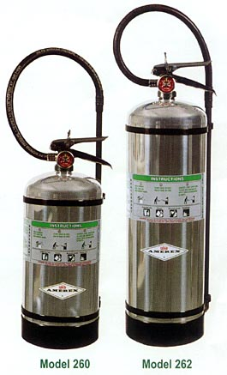
Characteristics
Type D (30 lb.) 6 - 8 ft. 30 sec.
Type K 8 - 12 ft. 50-75 sec.

Slide 25
Using a Fire Extinguisher
There is a simple acronym to remember how to operate most fire extinguishers - PASS.
PASS stands for Pull, Aim, Squeeze and Sweep.
Pull the pin at the top of the cylinder. Some units require the releasing of a lock latch or pressing a puncture lever.
Aim the nozzle at the base of the fire.
Squeeze or press the handle.
Sweep the contents from side to side at the base of the fire until it goes out.

Slide 26
When to Fight a Fire
You should fight a fire with a fire extinguisher only when all the following are true:
Everyone has left or is leaving the building.
The fire department has been called.
The fire is small and confined to the immediate areas where it started such as in a wastebasket, cushion, small appliance, stove, etc.
You can fight the fire with your back to a safe escape route.
Your extinguisher is rated for the type of fire you are fighting and is in good working order.
You have had training in use of the extinguisher and are confident that you can operate it effectively.

Slide 27
When not to Fight a Fire
Don’t try to fight a fire if you are not trained in the proper use of a fire extinguisher, or if you do not feel comfortable using the fire extinguisher in a real fire situation.
Instead, close the door to slow down the spread of the fire, leave the building and activate the fire alarm on the way out.
Call 911 and report the fire.

Slide 28
Please contact the UGA Office of Fire and Life Safety if you need any of the following services:
You need a fire extinguisher added to your work area;
You need a fire extinguisher in your work area replaced;
You need a fire extinguisher recharged;
You would like to attend or schedule a Fire Safety Training course;
You have any fire safety related questions.
Thank you for your interest in fire safety. If we can assist you in any way, please feel free to contact us.
Our contact information:
Tim Lister Russell D. Dukes
Telephone: (706) 713-2726 Telephone: (706) 542-7165
E-mail: timothy.lister@uga.edu E-mail: rddukes@uga.edu

