Slide 1
DISCLAIMER & INSTRUCTIONS to Class A/B Operators
The slide presentation was developed to assist Class A/B Operators with providing Class C training.
There are no backgrounds, transitions or other specials codes embedded in the PowerPoint, which allows you to insert your institution graphic, if desired. If you need help with inserting photos, text, & or graphic, please let me know.
Site specific or institutional items are not required to be included in this training material. However, BOR recommends that a sufficient level of site specific information be provided per the discretion of the Class A/B Operator responsible for providing the training materials to Class C Operators.
The State of Georgia requires a minimum that all Class C Operators be trained to:
Location and function of emergency stop for pumps (slide 11)
Basic emergency/notification procedures (slides 17-19 & 22)
Location of spill kits materials (slide 20)
Sign (wet signature or electronic) an acknowledge that training was received and completed (slide 25 & Separate MS Word file)

Slide 2
Operator Training Course Underground Petroleum Storage Tank Systems - Class C Operators
Educational Resource for Class A & B Operators at USG Institutions & Skidaway

Slide 3
What should Class C Operators learn?
Review of Basic and Site Specific Information (including, but not limited to):
Definitions
Emergency Procedures (alarms, spills, releases, fire extinguishers, first aid, notification, etc.);
Familiarity with equipment function;
Safety hazards of gasoline & related products;
Fuel handling & dispensing;

Slide 4
Legal Basis
Law
Official Code of Georgia Annotated (O.C.G.A.) TITLE 12 Chapter 13 (Georgia Underground Storage Act)
Energy Policy Act of 2005 (Federal)
Rule
GA Chapter 391-3-15 (Underground Storage Tank Management)

Slide 5
Definitions
“Underground storage tank” or “UST” means any one or combination of tanks, including underground pipes connected thereto, which is used to contain an accumulation of regulated substances and the volume of which, including the volume of the underground pipes connected thereto, is 10 percent or more beneath the surface of the ground.
“UST system” or “Tank System” means an underground storage tank and its associated ancillary equipment and containment system, if any.

Slide 6
What is not a UST?
Examples (Check 391-3-15-.02 for specific exemptions)
Types of tanks not regulated as USTs:
Farm, residential, heating oil, septic, Flow-through process, hazardous wastes, stormwater, wastewater, & otherwise materials covered under other regulations;
UST system whose capacity is 110 gallons or less;
UST system that contains a “de minimis” concentration of regulated substances;
Emergency spill or overflow containment UST system that is expeditiously emptied after use; and
Certain piping systems

Slide 7
What is a Class C Operator in Georgia:
“An individual who is the first line of response to events indicating UST emergency conditions, including but not limited to, taking appropriate action in response to emergencies or alarms caused by spills or releases from an UST system.” (391-3-15-.02)

Slide 8
Who is responsible for providing training?
The Class A/B Operator responsible for the UST site must provide the Class C Operator training;

Slide 9
When is Class C training required?
Prior to assuming responsibility for responding to emergencies of a UST with regulated fuel;
Specific site training is required for each UST site;
All regular USG employees (as designed by HR) with responsibility of dispensing fuel from a USG owned/operated underground storage tank must be trained to standards of the Class C requirements.

Slide 10
Training Exceptions
Class C training is NOT required:
if the USG UST dispensing site has a dedicated Class C attendant on duty during dispensing, (think of a typical gas station)
Farm or residential tank (<1,100 gallon capacity) used for storing motor fuel for noncommercial purposes
Notes:
(2) UST Exclusions. The term “underground storage tank” or “UST” does not include
any:
(a) Farm or residential tank of 1,100 gallons or less capacity used for storing motor fuel
for noncommercial purposes;
(b) Tank used for storing heating oil for consumptive use on the premises where stored;
(c) Septic tank;
(d) Pipeline facility (including gathering lines) which is regulated under:
1. the Natural Gas Pipeline Safety Act of 1968 (49 U.S.C. App. 1671 et seq.), or
2. the Hazardous Liquid Pipeline Safety Act of 1979 (49 U.S.C. App. 2001 et seq.), or
3. which is an intrastate pipeline facility regulated under State laws comparable to the
provisions of the law referred to in subparagraph (d)1. or (d)2. of this definition;
(e) Surface impoundment, pit, pond, or lagoon;
(f) Storm water or wastewater collection system;
(g) Flow-through process tank;
(h) Liquid trap or associated gathering lines directly related to oil or gas production and
gathering operations;
(i) Storage tank situated in an underground area (such as a basement, cellar,
mineworking, drift, shaft, or tunnel) if the storage tank is situated upon or above the
surface of the floor;
(j) UST system holding hazardous wastes listed or identified under Subtitle C of the Solid
Waste Disposal Act, or a mixture of such hazardous waste and other regulated
substances;
(k) Wastewater treatment tank system that is part of a wastewater treatment facility
regulated under section 402 or 307(b) of the Clean Water Act;
(l) Equipment or machinery that contains regulated substances for operational purposes
such as hydraulic lift tank and electrical equipment tank;
(m) UST system whose capacity is 110 gallons or less;
(n) UST system that conta ins a “de minimis” concentration of regulated substances;
(o) Emergency spill or overflow containment UST system that is expeditiously emptied
after use; or
(p) Pipes connected to any tank which is described in subparagraphs (a) through (o) of
this definition.

Slide 11
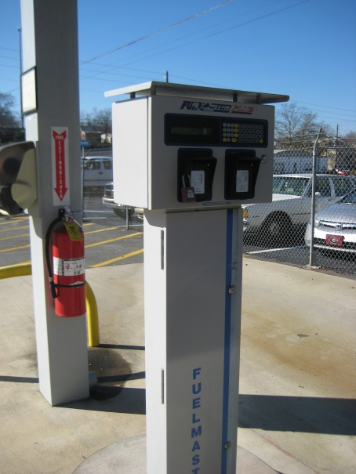
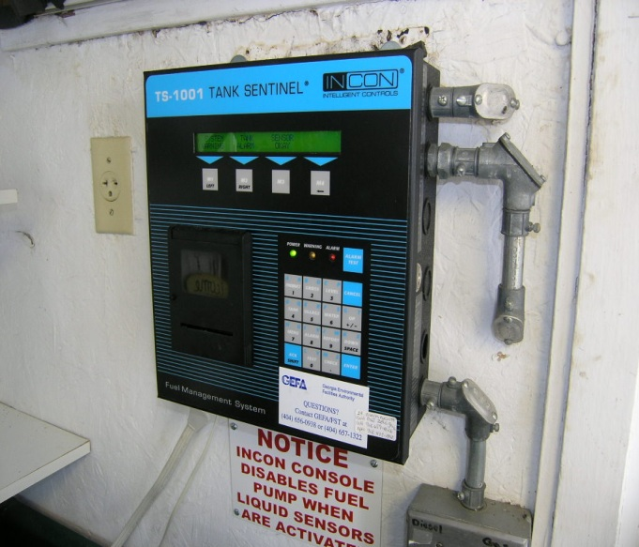
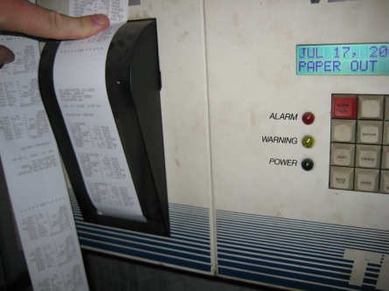
What are the UST components?
Class C Operators should be familiar with basic layout of the UST system
INSERT Site Specific or generic (alarms, control panels, delivery point, etc)
Typical Examples: Fuel Master Control (top), Leak Detection System (bottom)
Provided by GEFA – Typical INCON System (fuel management system)(left) & Signage/emergency stop (bottom-right)

Slide 12
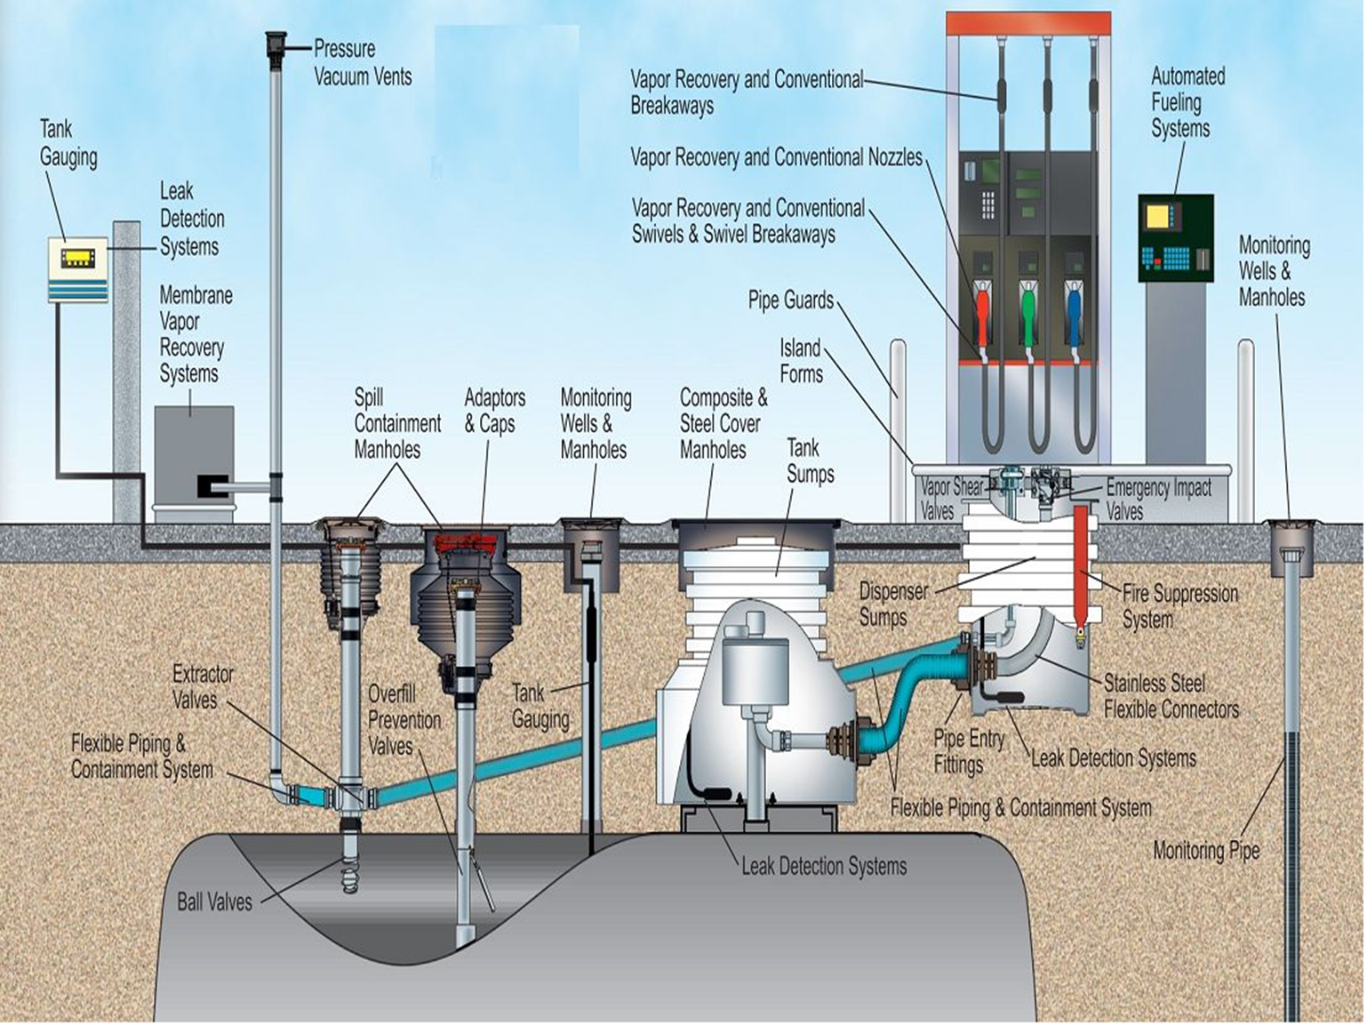
Example Layout
Provided by GEFA

Slide 13
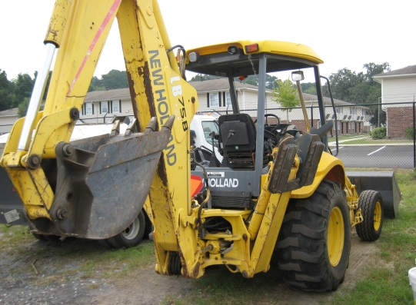
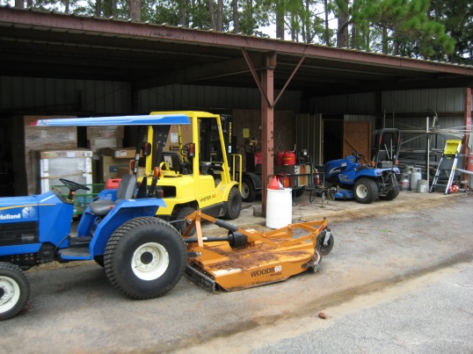
Fuel Handling Safety Guidelines
Turn vehicles or equipment off prior to refueling.
Don't smoke, light matches or use lighters while refueling.
Always stay at the pump during refueling and do not re-enter the vehicle (static electricity).
Do not over-fill or top-off your vehicle tank, which can cause gasoline spillage.
Never allow children under licensed driving age to operate the pump.

Slide 14
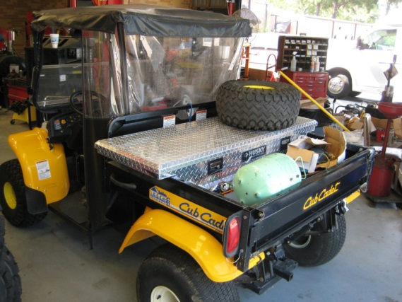
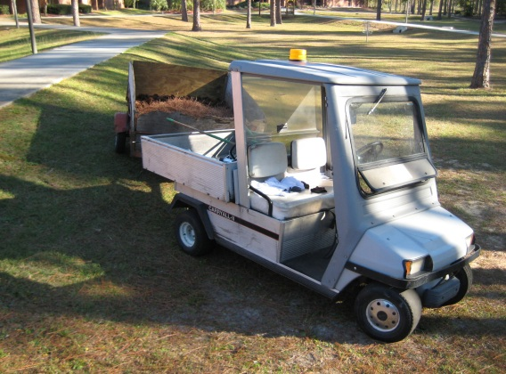
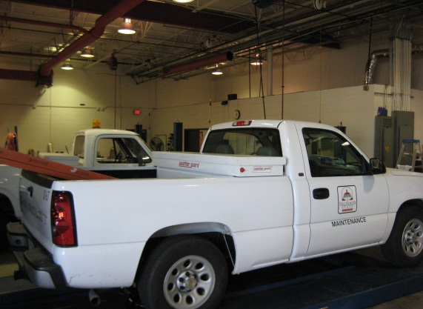
Fuel Handling Safety Guidelines (cont)
Avoid prolonged breathing of gasoline vapors.
Use gasoline only in open areas that get plenty of fresh air.
Keep your face away from the nozzle or container opening.
Never siphon gasoline by mouth nor put gasoline in your mouth for any reason.
Gasoline can be harmful or fatal if swallowed.
If someone swallows gasoline, do not induce vomiting.

Slide 15
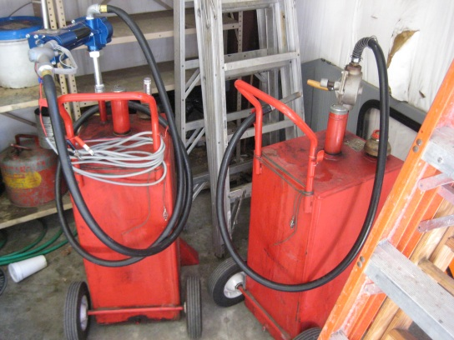
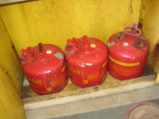
Dispensing fuel into a container
Use only an approved portable container and place it on the ground to avoid a possible static electricity ignition of fuel vapors.
Containers should never be filled while inside a vehicle or its trunk, the bed of a pickup truck, or the floor of a trailer.
When filling a portable container, manually control the nozzle valve throughout the filling process.

Slide 16
Dispensing gasoline to container (cont.)
Fill a portable container slowly to decrease the chance of static electricity buildup and minimize spilling or splattering.
Keep the nozzle in contact with the rim of the container opening while refueling.
Fill container no more than 95 percent full to allow for expansion.
Place cap tightly on the container after filling - do not use containers that do not seal properly.

Slide 17
Dispensing gasoline to container (cont.)
Keep gasoline away from your eyes and skin; it may cause irritation.
Remove gasoline-soaked clothing immediately.
Use gasoline only as a motor fuel.
Never use gasoline to wash your hands or as a cleaning solvent.

Slide 18
What are some examples of emergencies?
Fire
Static electricity
Smoking
Filling hot machinery
Fuel Releases/Spills:
Delivery overflowing
Pouring out of car
Coming out of the ground
Hose pulled off the dispenser
Vehicle damages pump/dispenser
Health Exposure
Weather related disaster

Slide 19
Basic Emergency/Notification Procedures
Hit the "Emergency Stop Button”;
Call 911; (INSERT SITE SPECIFIC INFO)(i.e. 9-911)
Evacuate customers & non-essential personnel and keep pedestrian and vehicular traffic out of the danger area as much as possible;
Call your supervisor and/or the Class A/B Operator (whoever you have been instructed to notify); and
Contain & mitigate any release, so that it doesn’t go down a storm drain or go in the grass or go off the site.
Notes:
There are five steps that should be taken --- and in
this order if at all possible:
First: Hit the "Emergency Stop Button.“
Second: Call 911.
Third: Evacuate customers and non-essential personnel
and keep pedestrian and vehicular traffic
out of the danger area as much as possible.
Fourth: Call your supervisor and/or the Class AlB
Operator per the emergency instructions you have
received.
Fifth and finally and only if it can be done safely:
Contain and mitigate any release -- so that it
doesn't go down a storm drain or go in the grass
or go off the site.

Slide 20
What should be posted at the site?
A sign denoting the emergency stop button
Emergency & Notification Procedures
This is generally located near the control panel and UST records
A list of trained operators (included UST records)

Slide 21
Spills & Cleanup Materials
A Class C Operator should know:
Location of any emergency materials, such as absorbent booms and pads, sandbags, and spill kits;
How to recognize a spill; and
Know basic response
INSERT SITE SPECIFIC INFO & PHOTO

Slide 22
Basic First Aid Procedures
If you come into contact with gasoline or diesel fuel, it is important that you follow these procedures:
EYES: Flush with water for 15 minutes.
SKIN: Remove any gasoline soaked clothing and wash exposed areas with soap and water.
INGESTION: Call physician. DO NOT induce vomiting.
INHALATION: Remove to fresh air upon being over come and/or experiencing an unusual symptom (i.e. Dizziness, irritation of eyes, nose and throat, vomiting, headaches, drowsiness, and other central nervous system)

Slide 23
Other Site Specific Emergency/Notification Procedures
INSERT Site specific information (if not covered in previous slide)

Slide 24
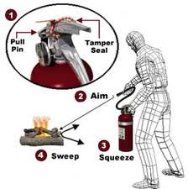
Use of Fire Extinguishers
Generally, fire extinguishers can be used by trained employees for flames not exceeding the size of a small trash pale. Use the P.A.S.S. (pull, aim, squeeze, & sweep) method when using a portable fire extinguisher.
Otherwise, retreat to a safe distance and follow the site specific emergency procedures.

Slide 25
Review of Basic Class C Operator Requirements
Are you aware of where the emergency numbers are located at the facility?
Have you been instructed on emergency procedures for the facility?
Should you ignore alarms or evidence of a release?
Do you know how to shut down the pumps at the facility, in case of an emergency?

Slide 26
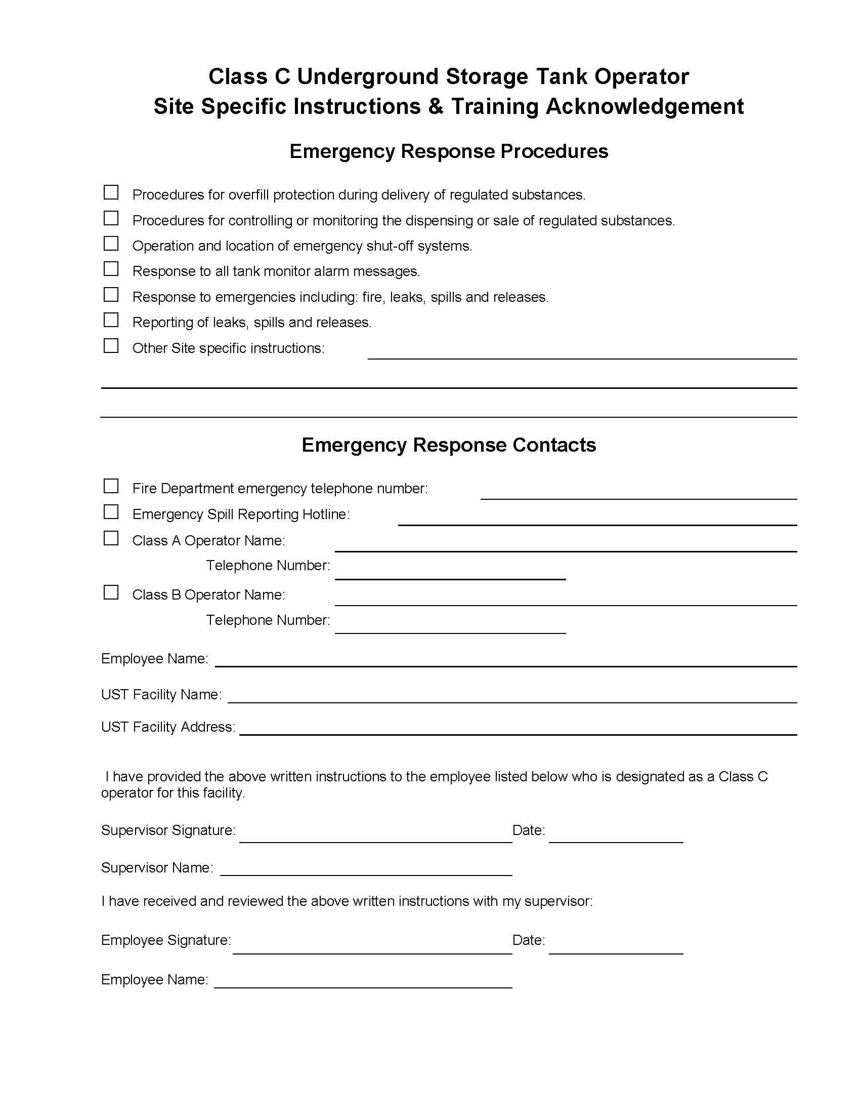
Class C Operator Training Acknowledgement & Checklist

Slide 27
Acknowledgements
Bill Greer (G-TEC)
American Petroleum Institute
Purdue University
Georgia Environmental Finance Authority
Office of Facilities, Board of Regents of the University System of Georgia (Graphics Library)

